Slide 1

AGENTIC AI
BUSINESS INNOVATION
COURSE SLIDES · NON-WSQ
Business Innovation with AI
Course Code: C798
Conducted by Tertiary Infotech Academy Pte Ltd · UEN 201200696W
Version v1.0 · 1 October 2026
© 2026 Tertiary Infotech Academy Pte Ltd. All rights reserved. · www.tertiarycourses.com.sg

Slide 2
COURSE ADMINISTRATION
Welcome & Course Orientation
Business Innovation with AI · C798
© 2026 Tertiary Infotech Academy Pte Ltd
1

Slide 3
YOUR TRAINER · TEMPLATE
About the Trainer
NAME
____________________________________________
?
DESIGNATION
____________________________________________
QUALIFICATIONS
____________________________________________
Your Trainer
AI EXPERIENCE
____________________________________________
To be completed by the trainer
INDUSTRY EXPERIENCE
____________________________________________
CONTACT
____________________________________________
Business Innovation with AI · C798
© 2026 Tertiary Infotech Academy Pte Ltd
2

Slide 4
YOUR TRAINER
About the Trainer
FOCUS
Business innovation, applied AI, automation and software delivery.
AA
PRACTICE
Designs practical AI-enabled workflows, courseware and digital products.
Dr. Alfred Ang
APPROACH
Evidence-led experimentation with explicit controls and human accountability.
Principal Trainer · Tertiary Infotech Academy
ORGANISATION
Tertiary Infotech Academy Pte Ltd · UEN 201200696W
Business Innovation with AI · C798
© 2026 Tertiary Infotech Academy Pte Ltd
3

Slide 5
LEARNER INTRODUCTION
Let's Know Each Other
Who are you?
Name, organisation and current role.
Where is the friction?
One repetitive or slow workflow in your work.
1
2
What have you tried?
Your experience with generative AI, automation or agents.
What would success mean?
A business outcome you want AI to improve.
3
4
Business Innovation with AI · C798
© 2026 Tertiary Infotech Academy Pte Ltd
4

Slide 6
HOUSEKEEPING
Ground Rules
Phones on silent
Participate actively
Respect different views
1
2
3
One conversation at a time
Return punctually
Protect confidential data
4
5
6
Business Innovation with AI · C798
© 2026 Tertiary Infotech Academy Pte Ltd
5

Slide 7
SCHEDULE · 09:30–17:30
One-Day Learning Journey
Morning
Afternoon
Wrap-up
• 09:30 orientation
• Topics 1–2
• Labs 1–2
• Topics 3–5
• Labs 3–5
• Implementation roadmap
• Course recap and Q&A
• Implementation commitments
• Course feedback · 17:30 close
Business Innovation with AI · C798
© 2026 Tertiary Infotech Academy Pte Ltd
6

Slide 8
01
TOPIC 01
Evolution of Business AI from Generative AI to Autonomous AI Agents
2023-2026 timeline · prompt to context to harness · AI-enabled business models
Business Innovation with AI · C798
© 2026 Tertiary Infotech Academy Pte Ltd
7

Slide 9
TOPIC 01 · KEY CONCEPTS
Key Concepts — Topic 1
2023 — generate
Copilots and chat interfaces made content generation broadly usable.
2024 — connect
Tool use, retrieval and multimodal models connected AI to business knowledge.
1
2
2025 — act
Agentic systems planned and executed multi-step work with tools and approvals.
2026 — operate
Persistent agents, digital workers and orchestration systems coordinate ongoing work.
3
4
Engineering progression
Prompt engineering → context engineering → harness engineering.
Business progression
AI feature → redesigned workflow → AI-enabled operating model.
5
6
Business Innovation with AI · C798
© 2026 Tertiary Infotech Academy Pte Ltd
8

Slide 10
TOPIC 01 · CONCEPT DEEP DIVE
1.1 Concept Lens — 2023 — generate
Meaning
Copilots and chat interfaces made content generation broadly usable.
Business question
Where does 2023 — generate change value, workflow, decision quality or capacity?
1
2
Evidence to collect
Baseline, approved sources, process owner, acceptance criterion and observed result.
Control to retain
Name the human owner, allowed action, exception path and review point.
3
4
Business Innovation with AI · C798
© 2026 Tertiary Infotech Academy Pte Ltd
9

Slide 11
TOPIC 01 · CONCEPT DEEP DIVE
1.2 Concept Lens — 2024 — connect
Meaning
Tool use, retrieval and multimodal models connected AI to business knowledge.
Business question
Where does 2024 — connect change value, workflow, decision quality or capacity?
1
2
Evidence to collect
Baseline, approved sources, process owner, acceptance criterion and observed result.
Control to retain
Name the human owner, allowed action, exception path and review point.
3
4
Business Innovation with AI · C798
© 2026 Tertiary Infotech Academy Pte Ltd
10

Slide 12
TOPIC 01 · CONCEPT DEEP DIVE
1.3 Concept Lens — 2025 — act
Meaning
Agentic systems planned and executed multi-step work with tools and approvals.
Business question
Where does 2025 — act change value, workflow, decision quality or capacity?
1
2
Evidence to collect
Baseline, approved sources, process owner, acceptance criterion and observed result.
Control to retain
Name the human owner, allowed action, exception path and review point.
3
4
Business Innovation with AI · C798
© 2026 Tertiary Infotech Academy Pte Ltd
11

Slide 13
TOPIC 01 · CONCEPT DEEP DIVE
1.4 Concept Lens — 2026 — operate
Meaning
Persistent agents, digital workers and orchestration systems coordinate ongoing work.
Business question
Where does 2026 — operate change value, workflow, decision quality or capacity?
1
2
Evidence to collect
Baseline, approved sources, process owner, acceptance criterion and observed result.
Control to retain
Name the human owner, allowed action, exception path and review point.
3
4
Business Innovation with AI · C798
© 2026 Tertiary Infotech Academy Pte Ltd
12

Slide 14
TOPIC 01 · CONCEPT DEEP DIVE
1.5 Concept Lens — Engineering progression
Meaning
Prompt engineering → context engineering → harness engineering.
Business question
Where does engineering progression change value, workflow, decision quality or capacity?
1
2
Evidence to collect
Baseline, approved sources, process owner, acceptance criterion and observed result.
Control to retain
Name the human owner, allowed action, exception path and review point.
3
4
Business Innovation with AI · C798
© 2026 Tertiary Infotech Academy Pte Ltd
13

Slide 15
TOPIC 01 · CONCEPT DEEP DIVE
1.6 Concept Lens — Business progression
Meaning
AI feature → redesigned workflow → AI-enabled operating model.
Business question
Where does business progression change value, workflow, decision quality or capacity?
1
2
Evidence to collect
Baseline, approved sources, process owner, acceptance criterion and observed result.
Control to retain
Name the human owner, allowed action, exception path and review point.
3
4
Business Innovation with AI · C798
© 2026 Tertiary Infotech Academy Pte Ltd
14

Slide 16
TOPIC 01 · BUSINESS FRAMEWORK
1.F1 Framework — AI maturity ladder
What it explains
When to use it
Watch for
• Classify an initiative as assistive, connected, agentic or operational. Maturity is determined by responsibility, access and persistence - not by marketing language.
• Use the ladder to prevent a content-generation pilot from being governed as if it could change business records.
• A common failure is granting autonomy before the process, data and escalation path are stable.
Business Innovation with AI · C798
© 2026 Tertiary Infotech Academy Pte Ltd
15

Slide 17
TOPIC 01 · FRAMEWORK APPLICATION 1
Apply AI maturity ladder to a governed decision
Problem
State the process problem that AI maturity ladder should clarify.
Baseline
Record current time, cost, error, experience or control performance.
Decision
Use AI maturity ladder to choose a bounded operating design.
1
2
3
Evidence
Specify the source, test result, metric and audit record required.
Human owner
Name who approves the consequential action and exception.
Review
Set the gate, threshold and date for continue, change or stop.
4
5
6
Business Innovation with AI · C798
© 2026 Tertiary Infotech Academy Pte Ltd
16

Slide 18
TOPIC 01 · BUSINESS FRAMEWORK
1.F2 Framework — Engineering progression
What it explains
When to use it
Watch for
• Prompt engineering shapes a request; context engineering curates the working set; harness engineering shapes the environment in which an agent acts.
• Use the progression to diagnose whether a weak result comes from wording, missing context or an unsafe execution environment.
• A longer prompt cannot compensate for missing evidence, unclear tool contracts or absent approvals.
Business Innovation with AI · C798
© 2026 Tertiary Infotech Academy Pte Ltd
17

Slide 19
TOPIC 01 · FRAMEWORK APPLICATION 2
Apply Engineering progression to a governed decision
Problem
State the process problem that Engineering progression should clarify.
Baseline
Record current time, cost, error, experience or control performance.
Decision
Use Engineering progression to choose a bounded operating design.
1
2
3
Evidence
Specify the source, test result, metric and audit record required.
Human owner
Name who approves the consequential action and exception.
Review
Set the gate, threshold and date for continue, change or stop.
4
5
6
Business Innovation with AI · C798
© 2026 Tertiary Infotech Academy Pte Ltd
18

Slide 20
TOPIC 01 · BUSINESS FRAMEWORK
1.F3 Framework — Business-model redesign
What it explains
When to use it
Watch for
• Examine value proposition, customer interface, key activities, resources, partners, revenue and cost through an AI-enabled lens.
• Use this framework when AI changes how value is delivered rather than merely making one task faster.
• Do not automate an inefficient hand-off and call it innovation; redesign the flow and ownership.
Business Innovation with AI · C798
© 2026 Tertiary Infotech Academy Pte Ltd
19

Slide 21
TOPIC 01 · FRAMEWORK APPLICATION 3
Apply Business-model redesign to a governed decision
Problem
State the process problem that Business-model redesign should clarify.
Baseline
Record current time, cost, error, experience or control performance.
Decision
Use Business-model redesign to choose a bounded operating design.
1
2
3
Evidence
Specify the source, test result, metric and audit record required.
Human owner
Name who approves the consequential action and exception.
Review
Set the gate, threshold and date for continue, change or stop.
4
5
6
Business Innovation with AI · C798
© 2026 Tertiary Infotech Academy Pte Ltd
20

Slide 22
TOPIC 01 · BUSINESS FRAMEWORK
1.F4 Framework — Human-AI operating model
What it explains
When to use it
Watch for
• Allocate intent, judgement, repetition, approval, exception handling and accountability deliberately between people and systems.
• Use role clarity to show where an agent may recommend, prepare, execute or escalate.
• Avoid vague statements such as 'the AI handles it'; name the owner and approval threshold.
Business Innovation with AI · C798
© 2026 Tertiary Infotech Academy Pte Ltd
21

Slide 23
TOPIC 01 · FRAMEWORK APPLICATION 4
Apply Human-AI operating model to a governed decision
Problem
State the process problem that Human-AI operating model should clarify.
Baseline
Record current time, cost, error, experience or control performance.
Decision
Use Human-AI operating model to choose a bounded operating design.
1
2
3
Evidence
Specify the source, test result, metric and audit record required.
Human owner
Name who approves the consequential action and exception.
Review
Set the gate, threshold and date for continue, change or stop.
4
5
6
Business Innovation with AI · C798
© 2026 Tertiary Infotech Academy Pte Ltd
22

Slide 24
TOPIC 01 · WORKED BUSINESS CASE
Case 1.1 — From campaign brief to approved video
Scenario
Your decision
Evidence pack
• A retail SME needs weekly product videos but has a two-week agency cycle. The team trials Gemini/Veo for first drafts while brand and legal reviewers retain approval.
• Map the old and AI-enabled value chains. Identify new capabilities, costs, risks and human decisions.
• Business outcome and baseline
• Value and feasibility factors
• Risks, controls and human owner
• Next test or stage-gate decision
Business Innovation with AI · C798
© 2026 Tertiary Infotech Academy Pte Ltd
23

Slide 25
TOPIC 01 · WORKED BUSINESS CASE
Case 1.2 — Service operations redesign
Scenario
Your decision
Evidence pack
• A facilities company receives requests by email and relies on coordinators to copy data into three systems.
• Describe the difference between adding a drafting assistant and redesigning the operating model around a governed agent.
• Business outcome and baseline
• Value and feasibility factors
• Risks, controls and human owner
• Next test or stage-gate decision
Business Innovation with AI · C798
© 2026 Tertiary Infotech Academy Pte Ltd
24

Slide 26
TOPIC 01 · WORKED BUSINESS CASE
Case 1.3 — The autonomy claim
Scenario
Your decision
Evidence pack
• A vendor calls its chatbot an autonomous digital employee, but it has no tools, memory or persistent task state.
• Use the maturity ladder and agent definition to challenge the claim with evidence.
• Business outcome and baseline
• Value and feasibility factors
• Risks, controls and human owner
• Next test or stage-gate decision
Business Innovation with AI · C798
© 2026 Tertiary Infotech Academy Pte Ltd
25

Slide 27
TOPIC 01
Four years changed the unit of AI value
1
2
3
4
▶
▶
▶
2023 — Prompt → generated answer
2024 — Context + multimodal tools
2025 — Goal → multi-step execution
2026 — Persistent digital worker
Business Innovation with AI · C798
© 2026 Tertiary Infotech Academy Pte Ltd
26

Slide 28
TOPIC 01
AI value moved from content to completed work
Generative
Agentic
Autonomous
• Drafts an output
• Human coordinates the workflow
• Pursues an outcome
• System coordinates tools and feedback
• Operates over time
• Controls bound authority and persistence
Business Innovation with AI · C798
© 2026 Tertiary Infotech Academy Pte Ltd
27

Slide 29
TOPIC 01
Engineering evolved with agent responsibility
1
2
3
4
▶
▶
▶
Prompt
Context
Harness
Operating model
Business Innovation with AI · C798
© 2026 Tertiary Infotech Academy Pte Ltd
28

Slide 30
TOPIC 01
Traditional and AI-enabled business models
Traditional
AI-enabled
Design question
• People navigate apps
• Hand-offs, queues and fixed capacity
• People state intent
• Agents coordinate systems under policy
• Where must people decide?
• Where can software act safely?
Business Innovation with AI · C798
© 2026 Tertiary Infotech Academy Pte Ltd
29

Slide 31
LO1 · Topic 1 · PRACTICE
Create a Business Story Video with Gemini
LAB 1
Create a short business-innovation video with Gemini/Veo, then compare the human decisions, cycle time and controls with a conventional production process.
You'll build
A 6–8 second business story video, prompt record and before/after workflow comparison
Tools: Gemini, Veo video generation, browser download
Business Innovation with AI · C798
© 2026 Tertiary Infotech Academy Pte Ltd
30

Slide 32
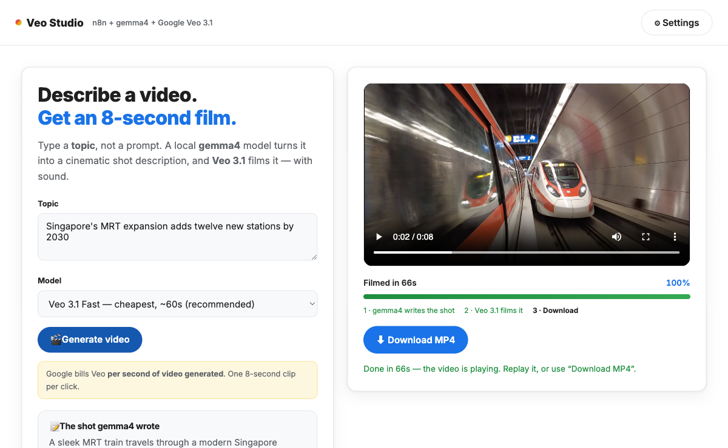
AUTHENTIC VISUAL
Lab 1 · Tool View
Business Innovation with AI · C798
© 2026 Tertiary Infotech Academy Pte Ltd
31

Slide 33
LAB 1 · LO1 · Topic 1 · ACCEPTANCE CHECK
Create a Business Story Video with Gemini
✅ Test it
The clip plays, matches the brief, contains no invented brand claims, and the comparison explains how generative AI changes cycle time without removing human accountability.
Business Innovation with AI · C798
© 2026 Tertiary Infotech Academy Pte Ltd
32

Slide 34
CHECK YOUR UNDERSTANDING
Topic 1 Recap
Business decision
2023-2026 timeline · prompt to context to harness · AI-enabled business models
Capability
Compare a generative-AI content workflow with a traditional production workflow
1
2
Control
Humans retain accountability for consequential outcomes.
Evidence
Use logs, tests and measurable acceptance criteria.
3
4
Business Innovation with AI · C798
© 2026 Tertiary Infotech Academy Pte Ltd
33

Slide 35
02
TOPIC 02
Generative AI, Agentic AI and AI Agent Technologies
LLMs · models, workflows and agents · n8n · Claude Code · Codex · OpenClaw · Hermes · Paperclip
Business Innovation with AI · C798
© 2026 Tertiary Infotech Academy Pte Ltd
34

Slide 36
TOPIC 02 · KEY CONCEPTS
Key Concepts — Topic 2
Generative AI
Produces a response or artifact from a prompt; the user drives each turn.
Agentic AI
Uses goals, state, tools and feedback to complete a multi-step outcome.
1
2
AI agent
A deployed system with model, instructions, memory, tools, skills and execution loop.
Workflow agent
n8n combines deterministic nodes, AI decisions and human approvals.
3
4
Coding agents
Claude Code and Codex inspect repositories, edit files, run tools and verify results.
Autonomous runtimes
OpenClaw and Hermes persist across channels; Paperclip coordinates teams of agents.
5
6
Business Innovation with AI · C798
© 2026 Tertiary Infotech Academy Pte Ltd
35

Slide 37
TOPIC 02 · CONCEPT DEEP DIVE
2.1 Concept Lens — Generative AI
Meaning
Produces a response or artifact from a prompt; the user drives each turn.
Business question
Where does generative ai change value, workflow, decision quality or capacity?
1
2
Evidence to collect
Baseline, approved sources, process owner, acceptance criterion and observed result.
Control to retain
Name the human owner, allowed action, exception path and review point.
3
4
Business Innovation with AI · C798
© 2026 Tertiary Infotech Academy Pte Ltd
36

Slide 38
TOPIC 02 · CONCEPT DEEP DIVE
2.2 Concept Lens — Agentic AI
Meaning
Uses goals, state, tools and feedback to complete a multi-step outcome.
Business question
Where does agentic ai change value, workflow, decision quality or capacity?
1
2
Evidence to collect
Baseline, approved sources, process owner, acceptance criterion and observed result.
Control to retain
Name the human owner, allowed action, exception path and review point.
3
4
Business Innovation with AI · C798
© 2026 Tertiary Infotech Academy Pte Ltd
37

Slide 39
TOPIC 02 · CONCEPT DEEP DIVE
2.3 Concept Lens — AI agent
Meaning
A deployed system with model, instructions, memory, tools, skills and execution loop.
Business question
Where does ai agent change value, workflow, decision quality or capacity?
1
2
Evidence to collect
Baseline, approved sources, process owner, acceptance criterion and observed result.
Control to retain
Name the human owner, allowed action, exception path and review point.
3
4
Business Innovation with AI · C798
© 2026 Tertiary Infotech Academy Pte Ltd
38

Slide 40
TOPIC 02 · CONCEPT DEEP DIVE
2.4 Concept Lens — Workflow agent
Meaning
n8n combines deterministic nodes, AI decisions and human approvals.
Business question
Where does workflow agent change value, workflow, decision quality or capacity?
1
2
Evidence to collect
Baseline, approved sources, process owner, acceptance criterion and observed result.
Control to retain
Name the human owner, allowed action, exception path and review point.
3
4
Business Innovation with AI · C798
© 2026 Tertiary Infotech Academy Pte Ltd
39

Slide 41
TOPIC 02 · CONCEPT DEEP DIVE
2.5 Concept Lens — Coding agents
Meaning
Claude Code and Codex inspect repositories, edit files, run tools and verify results.
Business question
Where does coding agents change value, workflow, decision quality or capacity?
1
2
Evidence to collect
Baseline, approved sources, process owner, acceptance criterion and observed result.
Control to retain
Name the human owner, allowed action, exception path and review point.
3
4
Business Innovation with AI · C798
© 2026 Tertiary Infotech Academy Pte Ltd
40

Slide 42
TOPIC 02 · CONCEPT DEEP DIVE
2.6 Concept Lens — Autonomous runtimes
Meaning
OpenClaw and Hermes persist across channels; Paperclip coordinates teams of agents.
Business question
Where does autonomous runtimes change value, workflow, decision quality or capacity?
1
2
Evidence to collect
Baseline, approved sources, process owner, acceptance criterion and observed result.
Control to retain
Name the human owner, allowed action, exception path and review point.
3
4
Business Innovation with AI · C798
© 2026 Tertiary Infotech Academy Pte Ltd
41

Slide 43
TOPIC 02 · BUSINESS FRAMEWORK
2.F1 Framework — Capability-behaviour-system taxonomy
What it explains
When to use it
Watch for
• Generative AI is a capability, agentic AI is goal-directed behaviour, and an AI agent is the deployed system that packages model, context, memory, tools and loop.
• Use the taxonomy to compare products without confusing a chatbot response with an operational agent.
• Do not infer autonomy from fluent language; inspect tools, state, persistence and permissions.
Business Innovation with AI · C798
© 2026 Tertiary Infotech Academy Pte Ltd
42

Slide 44
TOPIC 02 · FRAMEWORK APPLICATION 1
Apply Capability-behaviour-system taxonomy to a governed decision
Problem
State the process problem that Capability-behaviour-system taxonomy should clarify.
Baseline
Record current time, cost, error, experience or control performance.
Decision
Use Capability-behaviour-system taxonomy to choose a bounded operating design.
1
2
3
Evidence
Specify the source, test result, metric and audit record required.
Human owner
Name who approves the consequential action and exception.
Review
Set the gate, threshold and date for continue, change or stop.
4
5
6
Business Innovation with AI · C798
© 2026 Tertiary Infotech Academy Pte Ltd
43

Slide 45
TOPIC 02 · BUSINESS FRAMEWORK
2.F2 Framework — Agent architecture stack
What it explains
When to use it
Watch for
• Map goal, instructions, context, reasoning, memory, tools, skills, channels, loop, evaluator and human oversight.
• Use the stack to find missing components before selecting a platform.
• Adding more tools can increase risk and ambiguity; every tool needs a contract and owner.
Business Innovation with AI · C798
© 2026 Tertiary Infotech Academy Pte Ltd
44

Slide 46
TOPIC 02 · FRAMEWORK APPLICATION 2
Apply Agent architecture stack to a governed decision
Problem
State the process problem that Agent architecture stack should clarify.
Baseline
Record current time, cost, error, experience or control performance.
Decision
Use Agent architecture stack to choose a bounded operating design.
1
2
3
Evidence
Specify the source, test result, metric and audit record required.
Human owner
Name who approves the consequential action and exception.
Review
Set the gate, threshold and date for continue, change or stop.
4
5
6
Business Innovation with AI · C798
© 2026 Tertiary Infotech Academy Pte Ltd
45

Slide 47
TOPIC 02 · BUSINESS FRAMEWORK
2.F3 Framework — Technology selection matrix
What it explains
When to use it
Watch for
• Match the work boundary to generation, deterministic workflow, coding-agent, knowledge-worker or persistent digital-worker technology.
• Use a matrix of task variability, integrations, persistence, consequence and required evidence.
• Avoid choosing a fashionable tool before defining the business outcome and control boundary.
Business Innovation with AI · C798
© 2026 Tertiary Infotech Academy Pte Ltd
46

Slide 48
TOPIC 02 · FRAMEWORK APPLICATION 3
Apply Technology selection matrix to a governed decision
Problem
State the process problem that Technology selection matrix should clarify.
Baseline
Record current time, cost, error, experience or control performance.
Decision
Use Technology selection matrix to choose a bounded operating design.
1
2
3
Evidence
Specify the source, test result, metric and audit record required.
Human owner
Name who approves the consequential action and exception.
Review
Set the gate, threshold and date for continue, change or stop.
4
5
6
Business Innovation with AI · C798
© 2026 Tertiary Infotech Academy Pte Ltd
47

Slide 49
TOPIC 02 · BUSINESS FRAMEWORK
2.F4 Framework — Digital-worker boundary
What it explains
When to use it
Watch for
• Define what the worker may read, draft, decide, change, communicate and remember.
• Use the boundary as a practical contract between business owner, technology owner and users.
• Never treat an agent account as an unnamed employee; access and accountability must remain attributable.
Business Innovation with AI · C798
© 2026 Tertiary Infotech Academy Pte Ltd
48

Slide 50
TOPIC 02 · FRAMEWORK APPLICATION 4
Apply Digital-worker boundary to a governed decision
Problem
State the process problem that Digital-worker boundary should clarify.
Baseline
Record current time, cost, error, experience or control performance.
Decision
Use Digital-worker boundary to choose a bounded operating design.
1
2
3
Evidence
Specify the source, test result, metric and audit record required.
Human owner
Name who approves the consequential action and exception.
Review
Set the gate, threshold and date for continue, change or stop.
4
5
6
Business Innovation with AI · C798
© 2026 Tertiary Infotech Academy Pte Ltd
49

Slide 51
TOPIC 02 · WORKED BUSINESS CASE
Case 2.1 — Lead triage portfolio
Scenario
Your decision
Evidence pack
• A sales team needs structured intake, classification, CRM updates and manager approval for high-value leads.
• Compare n8n, a general chat assistant and a persistent agent against the required work boundary.
• Business outcome and baseline
• Value and feasibility factors
• Risks, controls and human owner
• Next test or stage-gate decision
Business Innovation with AI · C798
© 2026 Tertiary Infotech Academy Pte Ltd
50

Slide 52
TOPIC 02 · WORKED BUSINESS CASE
Case 2.2 — Repository modernisation
Scenario
Your decision
Evidence pack
• A product team needs an agent to inspect code, implement a change, run tests and prepare a reviewable diff.
• Compare Claude Code and Codex using context, tool, verification and human-control requirements.
• Business outcome and baseline
• Value and feasibility factors
• Risks, controls and human owner
• Next test or stage-gate decision
Business Innovation with AI · C798
© 2026 Tertiary Infotech Academy Pte Ltd
51

Slide 53
TOPIC 02 · WORKED BUSINESS CASE
Case 2.3 — Always-on operations assistant
Scenario
Your decision
Evidence pack
• A manager wants one agent reachable from chat and terminal that remembers approved preferences and runs scheduled briefings.
• Evaluate whether OpenClaw, Hermes Agent or a deterministic workflow is the better fit.
• Business outcome and baseline
• Value and feasibility factors
• Risks, controls and human owner
• Next test or stage-gate decision
Business Innovation with AI · C798
© 2026 Tertiary Infotech Academy Pte Ltd
52

Slide 54
TOPIC 02
What is a Large Language Model (LLM)?
Large
Learns patterns from very large collections of text and code.
Language
Represents text as tokens and learns relationships among them in context.
Model
A trained mathematical system whose parameters encode learned statistical patterns.
1
2
3
Inference
Given context, estimates probabilities for the next token and generates one token at a time.
Transformer
Attention helps the model relate relevant tokens across the supplied context.
Important limit
A fluent answer is a generated prediction, not automatic proof that the answer is true.
4
5
6
Business Innovation with AI · C798
© 2026 Tertiary Infotech Academy Pte Ltd
53

Slide 55
TOPIC 02
How an LLM turns text into a response
1
2
3
4
5
6
▶
▶
▶
▶
▶
Input text
Tokenise
Encode tokens
Apply attention
Predict next token
Repeat until stop
Business Innovation with AI · C798
© 2026 Tertiary Infotech Academy Pte Ltd
54

Slide 56
TOPIC 02
The LLM is the engine—not the whole agent
LLM
Harness
AI agent
• Predictive language model
• Generates and transforms content within supplied context
• Operational envelope
• Provides instructions, memory, tools, permissions, workflow and tests
• Goal-seeking system
• Runs the model in a loop, observes results and chooses the next controlled step
Business Innovation with AI · C798
© 2026 Tertiary Infotech Academy Pte Ltd
55

Slide 57
TOPIC 02
What an LLM can and cannot do alone
Strong at
Draft, summarise, extract, classify, translate, code and propose plans.
Does not own
Guaranteed facts, durable memory, current data, permissions or accountability.
Business-ready
Ground with approved knowledge, connect tools, validate outputs and retain human judgement.
1
2
3
Business Innovation with AI · C798
© 2026 Tertiary Infotech Academy Pte Ltd
56

Slide 58
TOPIC 02
Choose an LLM by the business requirement
Task quality
Evaluate on representative cases and failure modes, not a generic leaderboard alone.
Context capacity
Fit the instructions, evidence and working state needed for the task.
Speed and cost
Balance response time, volume, model price and total workflow cost.
1
2
3
Input and output
Check required text, image, audio, video, code and structured-data capabilities.
Tool reliability
Test tool calling, schema compliance and recovery from failed actions.
Risk boundary
Match privacy, security, residency, deployment and vendor controls to the data.
4
5
6
Business Innovation with AI · C798
© 2026 Tertiary Infotech Academy Pte Ltd
57

Slide 59
TOPIC 02
Generative AI, agentic AI and AI agents are not synonyms
Generative AI
Agentic AI
AI agent
• Capability
• Creates text, image, audio, video or code
• Behaviour
• Plans and adapts across multiple steps
• System
• Packages model, context, memory, tools and loop
Business Innovation with AI · C798
© 2026 Tertiary Infotech Academy Pte Ltd
58

Slide 60
TOPIC 02
An agent turns a goal into verified task execution
1
2
3
4
5
▶
▶
▶
▶
Goal
Reason
Use tools
Observe
Finish / escalate
Business Innovation with AI · C798
© 2026 Tertiary Infotech Academy Pte Ltd
59

Slide 61
TOPIC 02
The six building blocks of an AI agent
Reasoning
Instructions
Memory
1
2
3
Tools
Skills
Channels
4
5
6
Business Innovation with AI · C798
© 2026 Tertiary Infotech Academy Pte Ltd
60

Slide 62
TOPIC 02
Choose the technology by the work boundary
n8n
Claude Code
Codex
1
2
3
OpenClaw
Hermes Agent
Paperclip
4
5
6
Business Innovation with AI · C798
© 2026 Tertiary Infotech Academy Pte Ltd
61

Slide 63
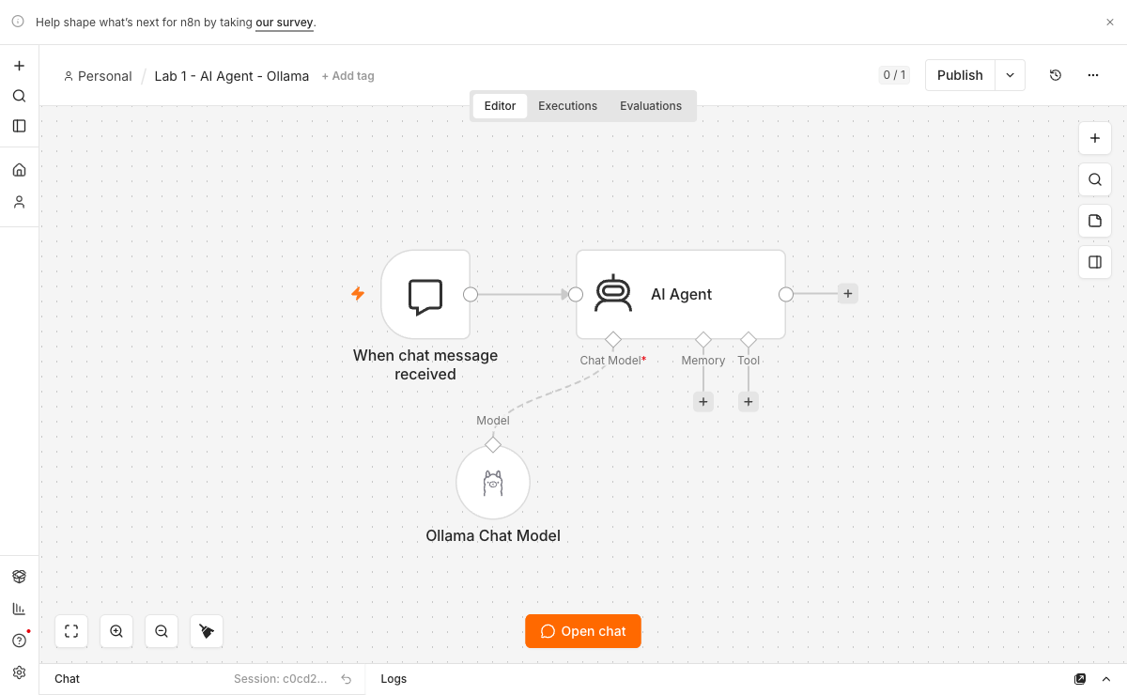
AUTHENTIC TOOL VIEW
n8n: visual orchestration with an AI agent
n8n editor showing trigger, AI Agent, chat model, memory and tool ports
Business Innovation with AI · C798
© 2026 Tertiary Infotech Academy Pte Ltd
62

Slide 64
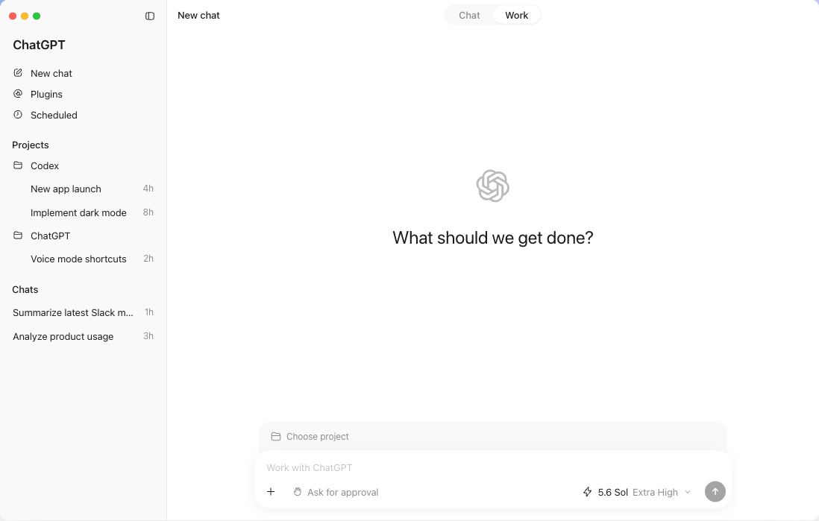
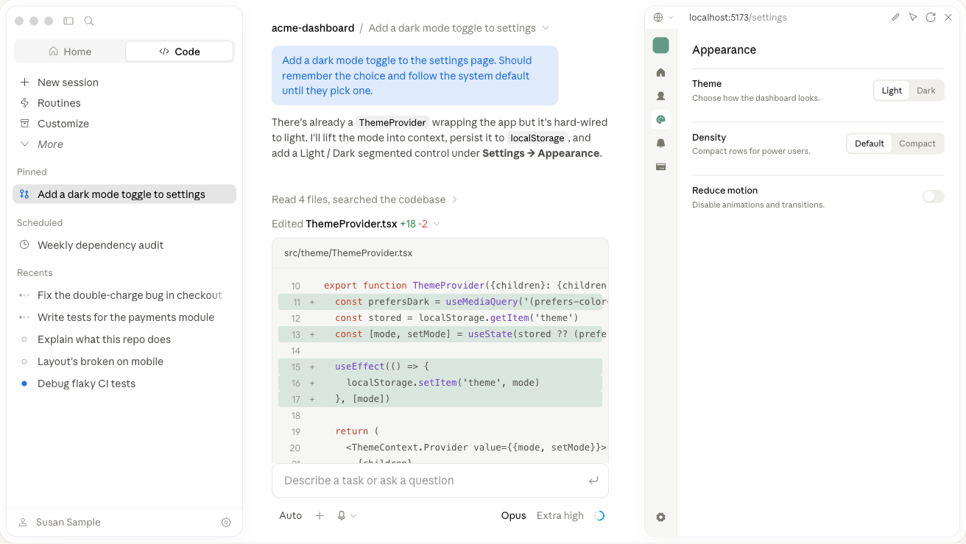
AUTHENTIC TOOL VIEWS
Coding agents operate on real repositories
Claude Code
Codex
Business Innovation with AI · C798
© 2026 Tertiary Infotech Academy Pte Ltd
63

Slide 65

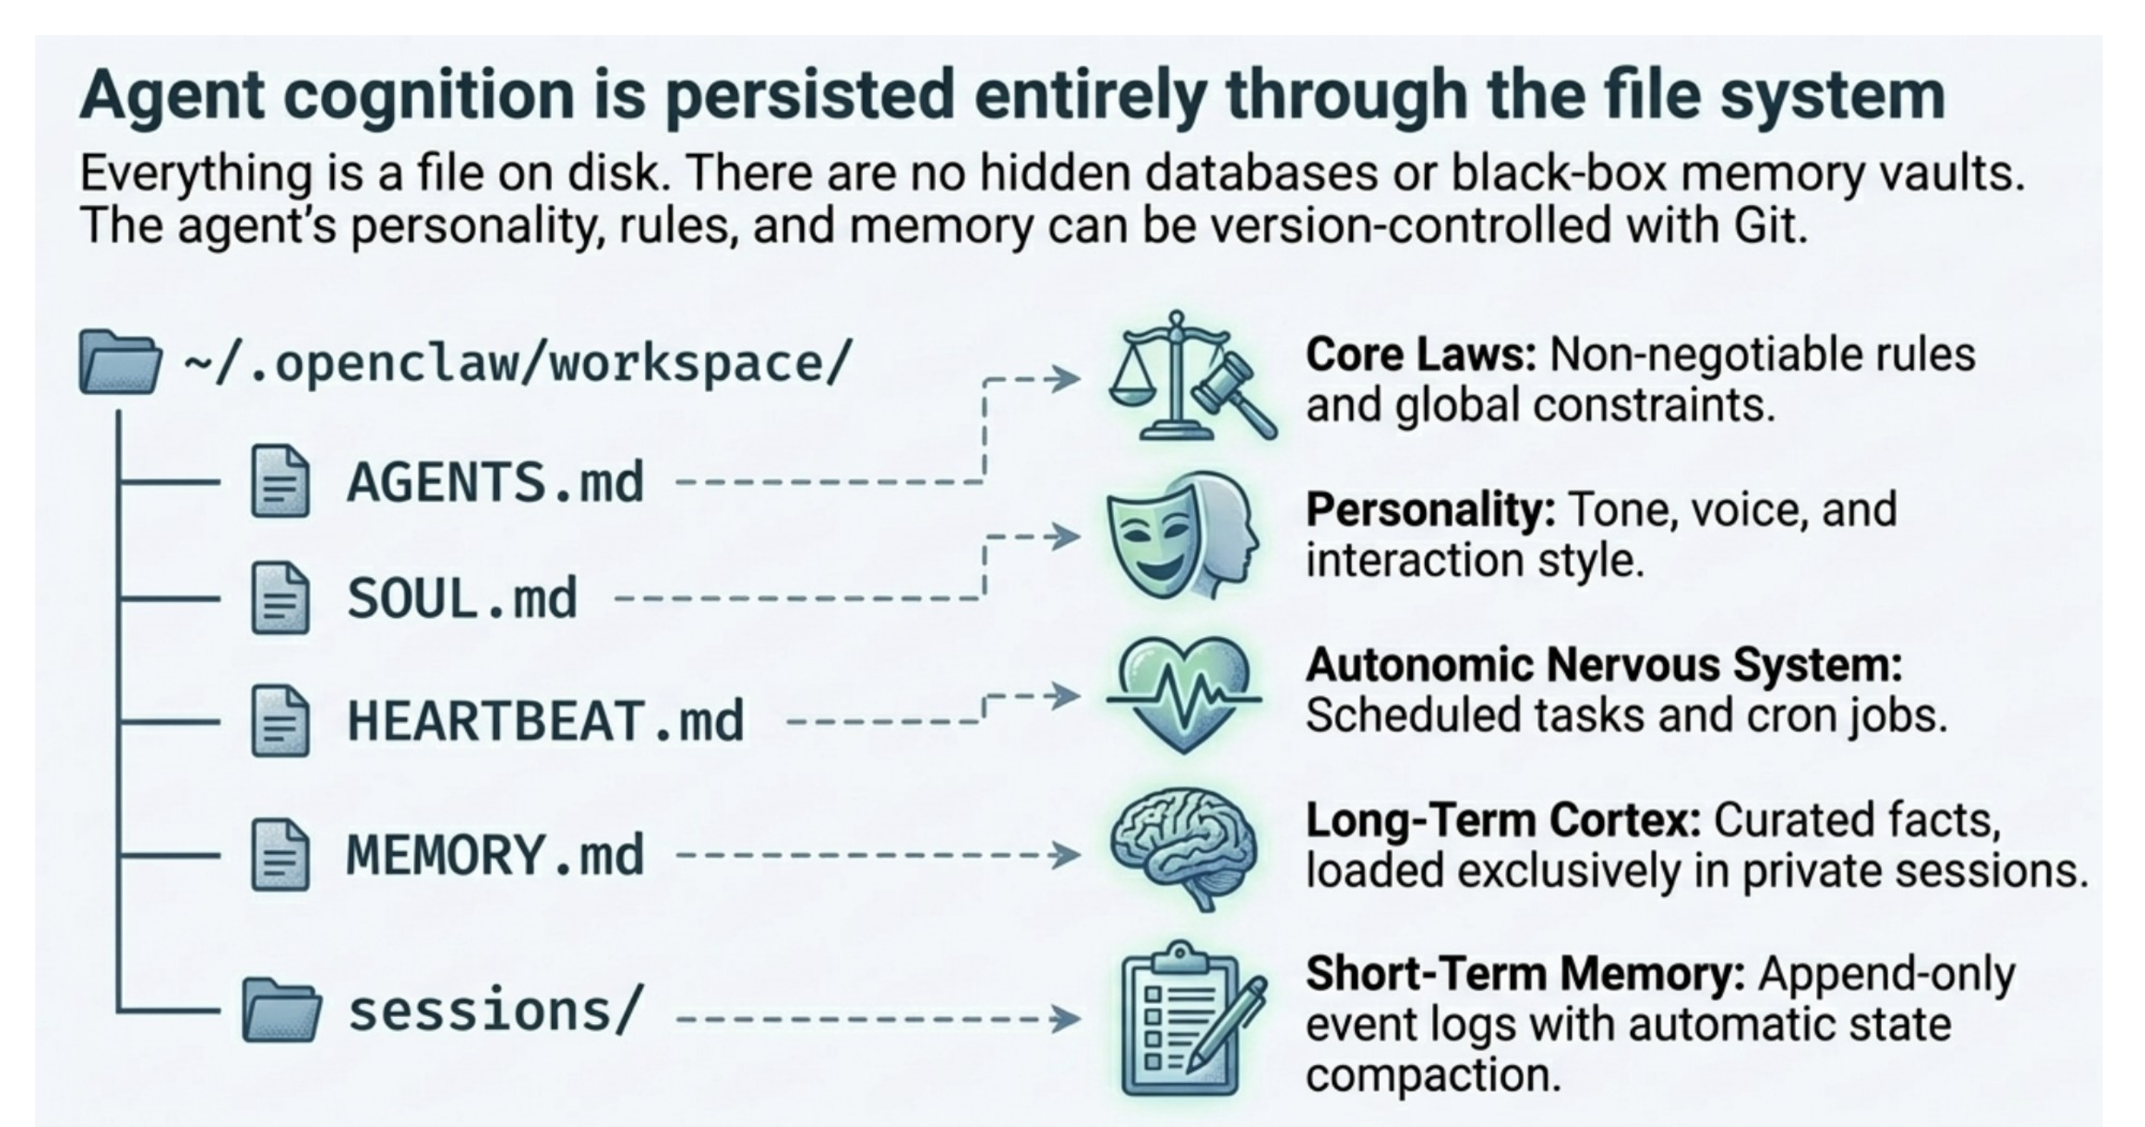
AGENT ECOSYSTEM
Persistent runtimes and agent teams
OpenClaw workspace
Paperclip agent orchestration
Business Innovation with AI · C798
© 2026 Tertiary Infotech Academy Pte Ltd
64

Slide 66
LO2-LO3 · Topic 2 · PRACTICE
Build an Agentic Lead-Triage Workflow in n8n
LAB 2
Build a controlled n8n workflow that receives a lead, asks an AI agent to classify intent and urgency, routes the result, records the decision and pauses high-value actions for approval.
You'll build
A lead-triage workflow with structured AI output, deterministic routing, audit data and human approval
Tools: n8n Form Trigger, AI Agent, Chat Model, Structured Output Parser, Switch, Data Table
Business Innovation with AI · C798
© 2026 Tertiary Infotech Academy Pte Ltd
65

Slide 67
N8N · CONTROLLED AGENTIC LOOP
Lab 2 · Governed Lead-Triage Flow
1
2
3
4
5
6
▶
▶
▶
▶
▶
Receive form
Classify to schema
Validate confidence
Route deterministically
Approve or queue
Write audit record
Business Innovation with AI · C798
© 2026 Tertiary Infotech Academy Pte Ltd
66

Slide 68
LAB 2 · LO2-LO3 · Topic 2 · ACCEPTANCE CHECK
Build an Agentic Lead-Triage Workflow in n8n
✅ Test it
All four test leads finish in the expected branch, every decision is logged, low-confidence or consequential actions require approval, and no unapproved external message is sent.
Business Innovation with AI · C798
© 2026 Tertiary Infotech Academy Pte Ltd
67

Slide 69
CHECK YOUR UNDERSTANDING
Topic 2 Recap
Business decision
LLMs · models, workflows and agents · n8n · Claude Code · Codex · OpenClaw · Hermes · Paperclip
Capability
Identify and apply a suitable agentic-AI technology to a business workflow
1
2
Control
Humans retain accountability for consequential outcomes.
Evidence
Use logs, tests and measurable acceptance criteria.
3
4
Business Innovation with AI · C798
© 2026 Tertiary Infotech Academy Pte Ltd
68

Slide 70
03
TOPIC 03
Context, Harness and Loop Engineering for AI Agents
Context · memory · instructions · tools · permissions · tests · oversight · iteration
Business Innovation with AI · C798
© 2026 Tertiary Infotech Academy Pte Ltd
69

Slide 71
TOPIC 03 · KEY CONCEPTS
Key Concepts — Topic 3
Context engineering
Select the right instructions, knowledge, memory and current state for each step.
Memory design
Separate working memory, durable preferences, business records and audit history.
1
2
Harness engineering
Shape the environment: permissions, tools, workflow, tests, logs and approvals.
Agentic loop
Plan → act → observe → evaluate → improve or stop.
3
4
Controls
Least privilege, allowlists, budgets, timeouts, idempotency, checkpoints and kill switches.
Human oversight
Humans set intent, approve consequential actions and resolve ambiguous outcomes.
5
6
Business Innovation with AI · C798
© 2026 Tertiary Infotech Academy Pte Ltd
70

Slide 72
TOPIC 03 · CONCEPT DEEP DIVE
3.1 Concept Lens — Context engineering
Meaning
Select the right instructions, knowledge, memory and current state for each step.
Business question
Where does context engineering change value, workflow, decision quality or capacity?
1
2
Evidence to collect
Baseline, approved sources, process owner, acceptance criterion and observed result.
Control to retain
Name the human owner, allowed action, exception path and review point.
3
4
Business Innovation with AI · C798
© 2026 Tertiary Infotech Academy Pte Ltd
71

Slide 73
TOPIC 03 · CONCEPT DEEP DIVE
3.2 Concept Lens — Memory design
Meaning
Separate working memory, durable preferences, business records and audit history.
Business question
Where does memory design change value, workflow, decision quality or capacity?
1
2
Evidence to collect
Baseline, approved sources, process owner, acceptance criterion and observed result.
Control to retain
Name the human owner, allowed action, exception path and review point.
3
4
Business Innovation with AI · C798
© 2026 Tertiary Infotech Academy Pte Ltd
72

Slide 74
TOPIC 03 · CONCEPT DEEP DIVE
3.3 Concept Lens — Harness engineering
Meaning
Shape the environment: permissions, tools, workflow, tests, logs and approvals.
Business question
Where does harness engineering change value, workflow, decision quality or capacity?
1
2
Evidence to collect
Baseline, approved sources, process owner, acceptance criterion and observed result.
Control to retain
Name the human owner, allowed action, exception path and review point.
3
4
Business Innovation with AI · C798
© 2026 Tertiary Infotech Academy Pte Ltd
73

Slide 75
TOPIC 03 · CONCEPT DEEP DIVE
3.4 Concept Lens — Agentic loop
Meaning
Plan → act → observe → evaluate → improve or stop.
Business question
Where does agentic loop change value, workflow, decision quality or capacity?
1
2
Evidence to collect
Baseline, approved sources, process owner, acceptance criterion and observed result.
Control to retain
Name the human owner, allowed action, exception path and review point.
3
4
Business Innovation with AI · C798
© 2026 Tertiary Infotech Academy Pte Ltd
74

Slide 76
TOPIC 03 · CONCEPT DEEP DIVE
3.5 Concept Lens — Controls
Meaning
Least privilege, allowlists, budgets, timeouts, idempotency, checkpoints and kill switches.
Business question
Where does controls change value, workflow, decision quality or capacity?
1
2
Evidence to collect
Baseline, approved sources, process owner, acceptance criterion and observed result.
Control to retain
Name the human owner, allowed action, exception path and review point.
3
4
Business Innovation with AI · C798
© 2026 Tertiary Infotech Academy Pte Ltd
75

Slide 77
TOPIC 03 · CONCEPT DEEP DIVE
3.6 Concept Lens — Human oversight
Meaning
Humans set intent, approve consequential actions and resolve ambiguous outcomes.
Business question
Where does human oversight change value, workflow, decision quality or capacity?
1
2
Evidence to collect
Baseline, approved sources, process owner, acceptance criterion and observed result.
Control to retain
Name the human owner, allowed action, exception path and review point.
3
4
Business Innovation with AI · C798
© 2026 Tertiary Infotech Academy Pte Ltd
76

Slide 78
TOPIC 03 · BUSINESS FRAMEWORK
3.F1 Framework — Context stack
What it explains
When to use it
Watch for
• Layer system instructions, task goal, constraints, source knowledge, current state, memory, examples and tool results.
• Use the stack to keep the working set relevant and to separate durable rules from temporary information.
• More context is not always better; irrelevant or conflicting material can reduce reliability.
Business Innovation with AI · C798
© 2026 Tertiary Infotech Academy Pte Ltd
77

Slide 79
TOPIC 03 · FRAMEWORK APPLICATION 1
Apply Context stack to a governed decision
Problem
State the process problem that Context stack should clarify.
Baseline
Record current time, cost, error, experience or control performance.
Decision
Use Context stack to choose a bounded operating design.
1
2
3
Evidence
Specify the source, test result, metric and audit record required.
Human owner
Name who approves the consequential action and exception.
Review
Set the gate, threshold and date for continue, change or stop.
4
5
6
Business Innovation with AI · C798
© 2026 Tertiary Infotech Academy Pte Ltd
78

Slide 80
TOPIC 03 · BUSINESS FRAMEWORK
3.F2 Framework — Memory lifecycle
What it explains
When to use it
Watch for
• Define capture, validation, storage, retrieval, update, expiry and deletion for every memory type.
• Use the lifecycle to distinguish working notes, approved preferences, business records and audit history.
• Do not store secrets, uncertain claims or personal data merely because an agent can remember them.
Business Innovation with AI · C798
© 2026 Tertiary Infotech Academy Pte Ltd
79

Slide 81
TOPIC 03 · FRAMEWORK APPLICATION 2
Apply Memory lifecycle to a governed decision
Problem
State the process problem that Memory lifecycle should clarify.
Baseline
Record current time, cost, error, experience or control performance.
Decision
Use Memory lifecycle to choose a bounded operating design.
1
2
3
Evidence
Specify the source, test result, metric and audit record required.
Human owner
Name who approves the consequential action and exception.
Review
Set the gate, threshold and date for continue, change or stop.
4
5
6
Business Innovation with AI · C798
© 2026 Tertiary Infotech Academy Pte Ltd
80

Slide 82
TOPIC 03 · BUSINESS FRAMEWORK
3.F3 Framework — Harness control plane
What it explains
When to use it
Watch for
• Combine permissions, tool schemas, workflow state, sandboxes, tests, evaluators, logs, approvals and recovery paths.
• Use the control plane to make the safe action the easiest action for the agent.
• A policy written only in prose is weak if the environment still permits the prohibited action.
Business Innovation with AI · C798
© 2026 Tertiary Infotech Academy Pte Ltd
81

Slide 83
TOPIC 03 · FRAMEWORK APPLICATION 3
Apply Harness control plane to a governed decision
Problem
State the process problem that Harness control plane should clarify.
Baseline
Record current time, cost, error, experience or control performance.
Decision
Use Harness control plane to choose a bounded operating design.
1
2
3
Evidence
Specify the source, test result, metric and audit record required.
Human owner
Name who approves the consequential action and exception.
Review
Set the gate, threshold and date for continue, change or stop.
4
5
6
Business Innovation with AI · C798
© 2026 Tertiary Infotech Academy Pte Ltd
82

Slide 84
TOPIC 03 · BUSINESS FRAMEWORK
3.F4 Framework — Loop state machine
What it explains
When to use it
Watch for
• Represent planning, action, observation, evaluation, retry, escalation, completion and stop as explicit states.
• Use state transitions to make retries, budgets and ownership observable.
• Unbounded retries create duplicate actions, cost and noise; every loop needs a stop condition.
Business Innovation with AI · C798
© 2026 Tertiary Infotech Academy Pte Ltd
83

Slide 85
TOPIC 03 · FRAMEWORK APPLICATION 4
Apply Loop state machine to a governed decision
Problem
State the process problem that Loop state machine should clarify.
Baseline
Record current time, cost, error, experience or control performance.
Decision
Use Loop state machine to choose a bounded operating design.
1
2
3
Evidence
Specify the source, test result, metric and audit record required.
Human owner
Name who approves the consequential action and exception.
Review
Set the gate, threshold and date for continue, change or stop.
4
5
6
Business Innovation with AI · C798
© 2026 Tertiary Infotech Academy Pte Ltd
84

Slide 86
TOPIC 03 · WORKED BUSINESS CASE
Case 3.1 — Conflicting policy sources
Scenario
Your decision
Evidence pack
• A knowledge-work agent receives two leave policies with different effective dates and produces a confident answer.
• Redesign context selection, source priority, evaluation and escalation so the conflict is visible.
• Business outcome and baseline
• Value and feasibility factors
• Risks, controls and human owner
• Next test or stage-gate decision
Business Innovation with AI · C798
© 2026 Tertiary Infotech Academy Pte Ltd
85

Slide 87
TOPIC 03 · WORKED BUSINESS CASE
Case 3.2 — Duplicate customer update
Scenario
Your decision
Evidence pack
• A tool call times out after sending an email, so the agent retries and sends the message twice.
• Specify idempotency, observation and retry controls that prevent the duplicate effect.
• Business outcome and baseline
• Value and feasibility factors
• Risks, controls and human owner
• Next test or stage-gate decision
Business Innovation with AI · C798
© 2026 Tertiary Infotech Academy Pte Ltd
86

Slide 88
TOPIC 03 · WORKED BUSINESS CASE
Case 3.3 — Memory without governance
Scenario
Your decision
Evidence pack
• An agent saves every conversation as durable memory, including tentative claims and personal information.
• Design memory categories, validation, retention and deletion rules.
• Business outcome and baseline
• Value and feasibility factors
• Risks, controls and human owner
• Next test or stage-gate decision
Business Innovation with AI · C798
© 2026 Tertiary Infotech Academy Pte Ltd
87

Slide 89
TOPIC 03
Reliable agents need three engineering layers
1
2
3
4
▶
▶
▶
Context
Harness
Loop
Governance
Business Innovation with AI · C798
© 2026 Tertiary Infotech Academy Pte Ltd
88

Slide 90
TOPIC 03
Context is a designed working set
Goal and constraints
Relevant knowledge
Current state
1
2
3
Durable memory
Tool results
Examples
4
5
6
Business Innovation with AI · C798
© 2026 Tertiary Infotech Academy Pte Ltd
89

Slide 91
TOPIC 03
The harness makes good behaviour easier
Scoped permissions
Tool contracts
Workflow state
1
2
3
Tests and evaluators
Logs and traces
Human checkpoints
4
5
6
Business Innovation with AI · C798
© 2026 Tertiary Infotech Academy Pte Ltd
90

Slide 92
TOPIC 03
The loop must know when to continue and when to stop
1
2
3
4
5
▶
▶
▶
▶
Plan
Act
Observe
Evaluate
Improve / stop
Business Innovation with AI · C798
© 2026 Tertiary Infotech Academy Pte Ltd
91

Slide 93
TOPIC 03
Controls prevent expensive or repetitive failure
Least privilege
Action allowlists
Budgets and timeouts
1
2
3
Idempotency
Loop limits
Kill switch
4
5
6
Business Innovation with AI · C798
© 2026 Tertiary Infotech Academy Pte Ltd
92

Slide 94
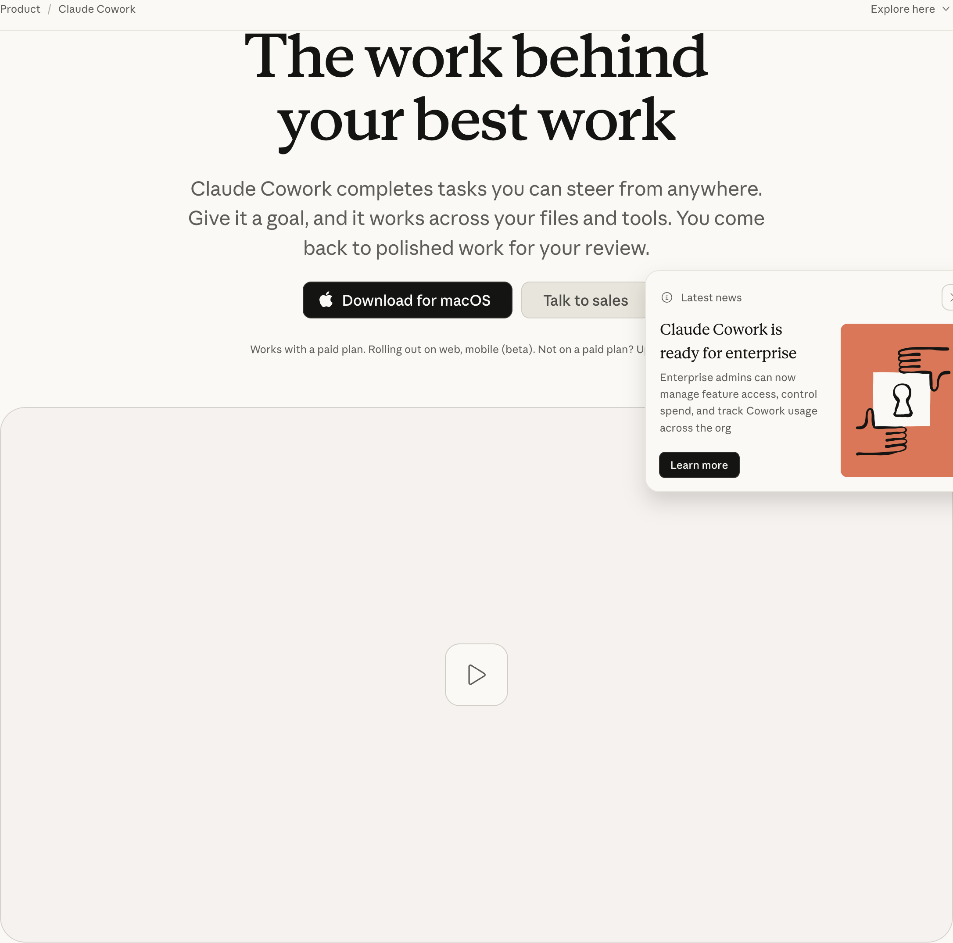
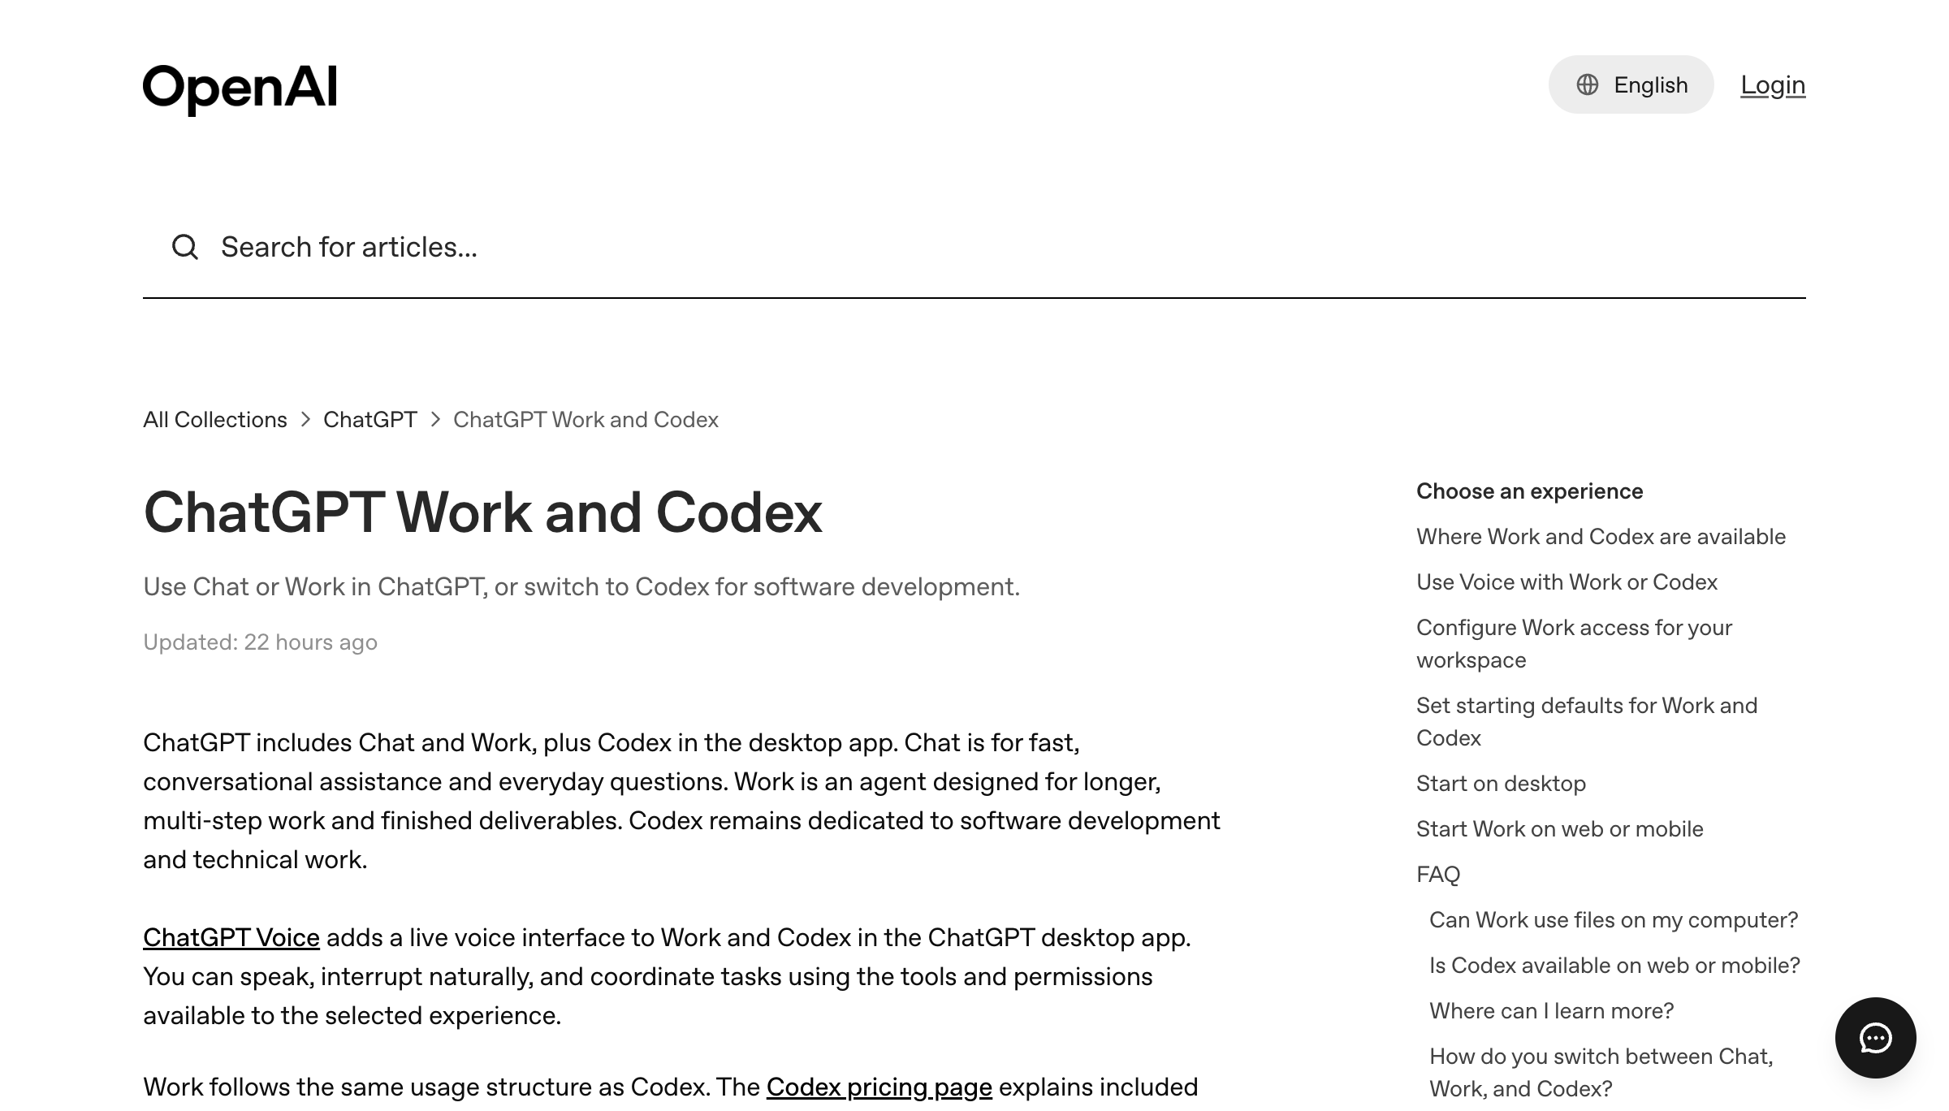
AUTHENTIC PRODUCT VIEWS
Knowledge-work agents need context and control
Claude Cowork
ChatGPT Work
Business Innovation with AI · C798
© 2026 Tertiary Infotech Academy Pte Ltd
93

Slide 95
LO3-LO4 · Topic 3 · PRACTICE
Delegate Knowledge Work with Claude Cowork and ChatGPT Work
LAB 3
Give the same business brief to Claude Cowork and ChatGPT Work, request a decision memo and action register, then compare how each system handles files, context, tool use, progress and approvals.
You'll build
Two evidence-grounded deliverables plus a context-and-harness comparison scorecard
Tools: Claude Cowork, ChatGPT Work, local files, connected apps where authorised
Business Innovation with AI · C798
© 2026 Tertiary Infotech Academy Pte Ltd
94

Slide 96
OBSERVE · COMPARE · IMPROVE
Lab 3 · Compare the work harness
Claude Cowork
ChatGPT Work
Business Innovation with AI · C798
© 2026 Tertiary Infotech Academy Pte Ltd
95

Slide 97
LAB 3 · LO3-LO4 · Topic 3 · ACCEPTANCE CHECK
Delegate Knowledge Work with Claude Cowork and ChatGPT Work
✅ Test it
Both deliverables trace claims to supplied sources, no unapproved external action occurs, the scorecard distinguishes context from harness quality, and the rerun improves a recorded acceptance measure.
Business Innovation with AI · C798
© 2026 Tertiary Infotech Academy Pte Ltd
96

Slide 98
CHECK YOUR UNDERSTANDING
Topic 3 Recap
Business decision
Context · memory · instructions · tools · permissions · tests · oversight · iteration
Capability
Design context, instructions, tools and human checkpoints for reliable knowledge work
1
2
Control
Humans retain accountability for consequential outcomes.
Evidence
Use logs, tests and measurable acceptance criteria.
3
4
Business Innovation with AI · C798
© 2026 Tertiary Infotech Academy Pte Ltd
97

Slide 99
04
TOPIC 04
Business Opportunities and Innovative Agentic AI Use Cases
Digital workers · natural-language interfaces · cross-system workflows · functional value
Business Innovation with AI · C798
© 2026 Tertiary Infotech Academy Pte Ltd
98

Slide 100
TOPIC 04 · KEY CONCEPTS
Key Concepts — Topic 4
Administration
Prepare documents, reconcile records, schedule follow-ups and route approvals.
Marketing
Research markets, create campaigns, generate video and learn from performance.
1
2
Sales
Enrich leads, draft outreach, update CRM and surface next-best actions.
Customer service
Retrieve knowledge, resolve routine cases and escalate exceptions with context.
3
4
Operations
Monitor events, coordinate systems, investigate anomalies and trigger playbooks.
Natural-language operations
People state intent; agents translate it into controlled software actions.
5
6
Business Innovation with AI · C798
© 2026 Tertiary Infotech Academy Pte Ltd
99

Slide 101
TOPIC 04 · CONCEPT DEEP DIVE
4.1 Concept Lens — Administration
Meaning
Prepare documents, reconcile records, schedule follow-ups and route approvals.
Business question
Where does administration change value, workflow, decision quality or capacity?
1
2
Evidence to collect
Baseline, approved sources, process owner, acceptance criterion and observed result.
Control to retain
Name the human owner, allowed action, exception path and review point.
3
4
Business Innovation with AI · C798
© 2026 Tertiary Infotech Academy Pte Ltd
100

Slide 102
TOPIC 04 · CONCEPT DEEP DIVE
4.2 Concept Lens — Marketing
Meaning
Research markets, create campaigns, generate video and learn from performance.
Business question
Where does marketing change value, workflow, decision quality or capacity?
1
2
Evidence to collect
Baseline, approved sources, process owner, acceptance criterion and observed result.
Control to retain
Name the human owner, allowed action, exception path and review point.
3
4
Business Innovation with AI · C798
© 2026 Tertiary Infotech Academy Pte Ltd
101

Slide 103
TOPIC 04 · CONCEPT DEEP DIVE
4.3 Concept Lens — Sales
Meaning
Enrich leads, draft outreach, update CRM and surface next-best actions.
Business question
Where does sales change value, workflow, decision quality or capacity?
1
2
Evidence to collect
Baseline, approved sources, process owner, acceptance criterion and observed result.
Control to retain
Name the human owner, allowed action, exception path and review point.
3
4
Business Innovation with AI · C798
© 2026 Tertiary Infotech Academy Pte Ltd
102

Slide 104
TOPIC 04 · CONCEPT DEEP DIVE
4.4 Concept Lens — Customer service
Meaning
Retrieve knowledge, resolve routine cases and escalate exceptions with context.
Business question
Where does customer service change value, workflow, decision quality or capacity?
1
2
Evidence to collect
Baseline, approved sources, process owner, acceptance criterion and observed result.
Control to retain
Name the human owner, allowed action, exception path and review point.
3
4
Business Innovation with AI · C798
© 2026 Tertiary Infotech Academy Pte Ltd
103

Slide 105
TOPIC 04 · CONCEPT DEEP DIVE
4.5 Concept Lens — Operations
Meaning
Monitor events, coordinate systems, investigate anomalies and trigger playbooks.
Business question
Where does operations change value, workflow, decision quality or capacity?
1
2
Evidence to collect
Baseline, approved sources, process owner, acceptance criterion and observed result.
Control to retain
Name the human owner, allowed action, exception path and review point.
3
4
Business Innovation with AI · C798
© 2026 Tertiary Infotech Academy Pte Ltd
104

Slide 106
TOPIC 04 · CONCEPT DEEP DIVE
4.6 Concept Lens — Natural-language operations
Meaning
People state intent; agents translate it into controlled software actions.
Business question
Where does natural-language operations change value, workflow, decision quality or capacity?
1
2
Evidence to collect
Baseline, approved sources, process owner, acceptance criterion and observed result.
Control to retain
Name the human owner, allowed action, exception path and review point.
3
4
Business Innovation with AI · C798
© 2026 Tertiary Infotech Academy Pte Ltd
105

Slide 107
TOPIC 04 · BUSINESS FRAMEWORK
4.F1 Framework — Opportunity discovery lens
What it explains
When to use it
Watch for
• Look for volume, repeated hand-offs, search across sources, frequent drafting, rules with exceptions and measurable delays.
• Use the lens during interviews and process walks to find friction that staff have normalised.
• High frequency alone is not enough; the outcome must matter and the process must be governable.
Business Innovation with AI · C798
© 2026 Tertiary Infotech Academy Pte Ltd
106

Slide 108
TOPIC 04 · FRAMEWORK APPLICATION 1
Apply Opportunity discovery lens to a governed decision
Problem
State the process problem that Opportunity discovery lens should clarify.
Baseline
Record current time, cost, error, experience or control performance.
Decision
Use Opportunity discovery lens to choose a bounded operating design.
1
2
3
Evidence
Specify the source, test result, metric and audit record required.
Human owner
Name who approves the consequential action and exception.
Review
Set the gate, threshold and date for continue, change or stop.
4
5
6
Business Innovation with AI · C798
© 2026 Tertiary Infotech Academy Pte Ltd
107

Slide 109
TOPIC 04 · BUSINESS FRAMEWORK
4.F2 Framework — Digital-worker canvas
What it explains
When to use it
Watch for
• Document customer, trigger, goal, inputs, decisions, tools, outputs, owner, controls, metrics and exceptions on one page.
• Use the canvas to align business and technical teams before prototyping.
• Do not begin integration work while the owner, success measure or prohibited actions remain unclear.
Business Innovation with AI · C798
© 2026 Tertiary Infotech Academy Pte Ltd
108

Slide 110
TOPIC 04 · FRAMEWORK APPLICATION 2
Apply Digital-worker canvas to a governed decision
Problem
State the process problem that Digital-worker canvas should clarify.
Baseline
Record current time, cost, error, experience or control performance.
Decision
Use Digital-worker canvas to choose a bounded operating design.
1
2
3
Evidence
Specify the source, test result, metric and audit record required.
Human owner
Name who approves the consequential action and exception.
Review
Set the gate, threshold and date for continue, change or stop.
4
5
6
Business Innovation with AI · C798
© 2026 Tertiary Infotech Academy Pte Ltd
109

Slide 111
TOPIC 04 · BUSINESS FRAMEWORK
4.F3 Framework — Natural-language control model
What it explains
When to use it
Watch for
• Translate human intent into a proposed plan, validated tool calls, previewed consequential actions and an auditable outcome.
• Use this model when an agent becomes the interface to multiple applications or datasets.
• Natural language is ambiguous; confirmations and structured parameters remain necessary.
Business Innovation with AI · C798
© 2026 Tertiary Infotech Academy Pte Ltd
110

Slide 112
TOPIC 04 · FRAMEWORK APPLICATION 3
Apply Natural-language control model to a governed decision
Problem
State the process problem that Natural-language control model should clarify.
Baseline
Record current time, cost, error, experience or control performance.
Decision
Use Natural-language control model to choose a bounded operating design.
1
2
3
Evidence
Specify the source, test result, metric and audit record required.
Human owner
Name who approves the consequential action and exception.
Review
Set the gate, threshold and date for continue, change or stop.
4
5
6
Business Innovation with AI · C798
© 2026 Tertiary Infotech Academy Pte Ltd
111

Slide 113
TOPIC 04 · BUSINESS FRAMEWORK
4.F4 Framework — Functional use-case map
What it explains
When to use it
Watch for
• Compare administration, marketing, sales, customer service, operations and management opportunities using shared criteria.
• Use the map to create a balanced portfolio instead of concentrating all pilots in content generation.
• Avoid counting the same underlying workflow as several separate use cases.
Business Innovation with AI · C798
© 2026 Tertiary Infotech Academy Pte Ltd
112

Slide 114
TOPIC 04 · FRAMEWORK APPLICATION 4
Apply Functional use-case map to a governed decision
Problem
State the process problem that Functional use-case map should clarify.
Baseline
Record current time, cost, error, experience or control performance.
Decision
Use Functional use-case map to choose a bounded operating design.
1
2
3
Evidence
Specify the source, test result, metric and audit record required.
Human owner
Name who approves the consequential action and exception.
Review
Set the gate, threshold and date for continue, change or stop.
4
5
6
Business Innovation with AI · C798
© 2026 Tertiary Infotech Academy Pte Ltd
113

Slide 115
TOPIC 04 · WORKED BUSINESS CASE
Case 4.1 — Administration digital worker
Scenario
Your decision
Evidence pack
• A finance team reconciles invoices, purchase orders and approvals across email, spreadsheets and an ERP.
• Identify the high-value agent boundary and the transactions that still require approval.
• Business outcome and baseline
• Value and feasibility factors
• Risks, controls and human owner
• Next test or stage-gate decision
Business Innovation with AI · C798
© 2026 Tertiary Infotech Academy Pte Ltd
114

Slide 116
TOPIC 04 · WORKED BUSINESS CASE
Case 4.2 — Customer-service interface
Scenario
Your decision
Evidence pack
• Customers describe problems in natural language; the agent searches knowledge, checks account status and proposes resolution.
• Design the hand-off between retrieval, tool use, confidence, escalation and customer communication.
• Business outcome and baseline
• Value and feasibility factors
• Risks, controls and human owner
• Next test or stage-gate decision
Business Innovation with AI · C798
© 2026 Tertiary Infotech Academy Pte Ltd
115

Slide 117
TOPIC 04 · WORKED BUSINESS CASE
Case 4.3 — Operations exception coordinator
Scenario
Your decision
Evidence pack
• A logistics agent monitors late events, investigates supporting data and proposes rerouting options.
• Define metrics, tool permissions and incident controls for a pilot.
• Business outcome and baseline
• Value and feasibility factors
• Risks, controls and human owner
• Next test or stage-gate decision
Business Innovation with AI · C798
© 2026 Tertiary Infotech Academy Pte Ltd
116

Slide 118
TOPIC 04
Digital workers coordinate across the system of work
1
2
3
4
5
▶
▶
▶
▶
Intent
Business context
Apps and data
Approval
Outcome + audit
Business Innovation with AI · C798
© 2026 Tertiary Infotech Academy Pte Ltd
117

Slide 119
TOPIC 04
Look for work with volume, friction and clear outcomes
Repeated hand-offs
Search across sources
Frequent drafting
1
2
3
Rules plus exceptions
Cross-system updates
Measurable cycle time
4
5
6
Business Innovation with AI · C798
© 2026 Tertiary Infotech Academy Pte Ltd
118

Slide 120
TOPIC 04
A natural-language interface changes who can operate software
Before
With agents
Control
• Learn each application
• People translate intent into clicks
• State goal and constraints
• Agent translates intent into tool calls
• Preview consequential actions
• Human remains accountable
Business Innovation with AI · C798
© 2026 Tertiary Infotech Academy Pte Ltd
119

Slide 121
TOPIC 04
Opportunity map across business functions
Administration
Marketing
Sales
1
2
3
Customer service
Operations
Management
4
5
6
Business Innovation with AI · C798
© 2026 Tertiary Infotech Academy Pte Ltd
120

Slide 122
LO2-LO4 · Topic 4 · PRACTICE
Build an AI Opportunity Scoring App with Claude Code and Codex
LAB 4
Use Claude Code and Codex on the same repository to build and verify a small browser app that scores business opportunities by value, feasibility, risk and human-oversight needs.
You'll build
A responsive opportunity-scoring web app with tests, sample data, README and review evidence
Tools: Claude Code, Codex, HTML/CSS/JavaScript, local browser, Git
Business Innovation with AI · C798
© 2026 Tertiary Infotech Academy Pte Ltd
121

Slide 123
PLAN · EDIT · TEST · REVIEW
Lab 4 · Build, review and verify
Claude Code
Codex
Business Innovation with AI · C798
© 2026 Tertiary Infotech Academy Pte Ltd
122

Slide 124
LAB 4 · LO2-LO4 · Topic 4 · ACCEPTANCE CHECK
Build an AI Opportunity Scoring App with Claude Code and Codex
✅ Test it
The app calculates the documented score, works at desktop and mobile widths, handles invalid inputs, passes its checks, and the final diff was reviewed by a human before acceptance.
Business Innovation with AI · C798
© 2026 Tertiary Infotech Academy Pte Ltd
123

Slide 125
CHECK YOUR UNDERSTANDING
Topic 4 Recap
Business decision
Digital workers · natural-language interfaces · cross-system workflows · functional value
Capability
Prototype an AI-enabled natural-language interface and compare coding-agent workflows
1
2
Control
Humans retain accountability for consequential outcomes.
Evidence
Use logs, tests and measurable acceptance criteria.
3
4
Business Innovation with AI · C798
© 2026 Tertiary Infotech Academy Pte Ltd
124

Slide 126
05
TOPIC 05
Evaluating and Implementing AI-Driven Business Innovation
Value and feasibility · process redesign · prototype · measurement · roadmap · governance
Business Innovation with AI · C798
© 2026 Tertiary Infotech Academy Pte Ltd
125

Slide 127
TOPIC 05 · KEY CONCEPTS
Key Concepts — Topic 5
Value
Revenue, cost, cycle time, quality, experience, capacity and strategic learning.
Feasibility
Data readiness, process stability, integration effort, skills, risk and change capacity.
1
2
Process redesign
Allocate judgement, repetition, approval and accountability deliberately between people and agents.
Prototype
Test a narrow workflow with representative cases, failure modes and measurable acceptance criteria.
3
4
Governance
Ownership, access, privacy, security, auditability, incident response and vendor controls.
Roadmap
Discover → prioritise → prototype → pilot → scale → monitor and continuously improve.
5
6
Business Innovation with AI · C798
© 2026 Tertiary Infotech Academy Pte Ltd
126

Slide 128
TOPIC 05 · CONCEPT DEEP DIVE
5.1 Concept Lens — Value
Meaning
Revenue, cost, cycle time, quality, experience, capacity and strategic learning.
Business question
Where does value change value, workflow, decision quality or capacity?
1
2
Evidence to collect
Baseline, approved sources, process owner, acceptance criterion and observed result.
Control to retain
Name the human owner, allowed action, exception path and review point.
3
4
Business Innovation with AI · C798
© 2026 Tertiary Infotech Academy Pte Ltd
127

Slide 129
TOPIC 05 · CONCEPT DEEP DIVE
5.2 Concept Lens — Feasibility
Meaning
Data readiness, process stability, integration effort, skills, risk and change capacity.
Business question
Where does feasibility change value, workflow, decision quality or capacity?
1
2
Evidence to collect
Baseline, approved sources, process owner, acceptance criterion and observed result.
Control to retain
Name the human owner, allowed action, exception path and review point.
3
4
Business Innovation with AI · C798
© 2026 Tertiary Infotech Academy Pte Ltd
128

Slide 130
TOPIC 05 · CONCEPT DEEP DIVE
5.3 Concept Lens — Process redesign
Meaning
Allocate judgement, repetition, approval and accountability deliberately between people and agents.
Business question
Where does process redesign change value, workflow, decision quality or capacity?
1
2
Evidence to collect
Baseline, approved sources, process owner, acceptance criterion and observed result.
Control to retain
Name the human owner, allowed action, exception path and review point.
3
4
Business Innovation with AI · C798
© 2026 Tertiary Infotech Academy Pte Ltd
129

Slide 131
TOPIC 05 · CONCEPT DEEP DIVE
5.4 Concept Lens — Prototype
Meaning
Test a narrow workflow with representative cases, failure modes and measurable acceptance criteria.
Business question
Where does prototype change value, workflow, decision quality or capacity?
1
2
Evidence to collect
Baseline, approved sources, process owner, acceptance criterion and observed result.
Control to retain
Name the human owner, allowed action, exception path and review point.
3
4
Business Innovation with AI · C798
© 2026 Tertiary Infotech Academy Pte Ltd
130

Slide 132
TOPIC 05 · CONCEPT DEEP DIVE
5.5 Concept Lens — Governance
Meaning
Ownership, access, privacy, security, auditability, incident response and vendor controls.
Business question
Where does governance change value, workflow, decision quality or capacity?
1
2
Evidence to collect
Baseline, approved sources, process owner, acceptance criterion and observed result.
Control to retain
Name the human owner, allowed action, exception path and review point.
3
4
Business Innovation with AI · C798
© 2026 Tertiary Infotech Academy Pte Ltd
131

Slide 133
TOPIC 05 · CONCEPT DEEP DIVE
5.6 Concept Lens — Roadmap
Meaning
Discover → prioritise → prototype → pilot → scale → monitor and continuously improve.
Business question
Where does roadmap change value, workflow, decision quality or capacity?
1
2
Evidence to collect
Baseline, approved sources, process owner, acceptance criterion and observed result.
Control to retain
Name the human owner, allowed action, exception path and review point.
3
4
Business Innovation with AI · C798
© 2026 Tertiary Infotech Academy Pte Ltd
132

Slide 134
TOPIC 05 · BUSINESS FRAMEWORK
5.F1 Framework — Value-feasibility matrix
What it explains
When to use it
Watch for
• Score value and feasibility separately before considering urgency or sponsorship.
• Use the matrix to distinguish pilot-now opportunities from prepare-first opportunities.
• A high-value idea with unstable data or unacceptable risk is not ready for automation.
Business Innovation with AI · C798
© 2026 Tertiary Infotech Academy Pte Ltd
133

Slide 135
TOPIC 05 · FRAMEWORK APPLICATION 1
Apply Value-feasibility matrix to a governed decision
Problem
State the process problem that Value-feasibility matrix should clarify.
Baseline
Record current time, cost, error, experience or control performance.
Decision
Use Value-feasibility matrix to choose a bounded operating design.
1
2
3
Evidence
Specify the source, test result, metric and audit record required.
Human owner
Name who approves the consequential action and exception.
Review
Set the gate, threshold and date for continue, change or stop.
4
5
6
Business Innovation with AI · C798
© 2026 Tertiary Infotech Academy Pte Ltd
134

Slide 136
TOPIC 05 · BUSINESS FRAMEWORK
5.F2 Framework — Total business case
What it explains
When to use it
Watch for
• Include labour, cycle time, quality, rework, revenue, integration, licences, model usage, oversight, change and risk exposure.
• Use ranges and sensitivity analysis rather than a single confident return estimate.
• Do not omit human review and maintenance costs from an agentic-AI business case.
Business Innovation with AI · C798
© 2026 Tertiary Infotech Academy Pte Ltd
135

Slide 137
TOPIC 05 · FRAMEWORK APPLICATION 2
Apply Total business case to a governed decision
Problem
State the process problem that Total business case should clarify.
Baseline
Record current time, cost, error, experience or control performance.
Decision
Use Total business case to choose a bounded operating design.
1
2
3
Evidence
Specify the source, test result, metric and audit record required.
Human owner
Name who approves the consequential action and exception.
Review
Set the gate, threshold and date for continue, change or stop.
4
5
6
Business Innovation with AI · C798
© 2026 Tertiary Infotech Academy Pte Ltd
136

Slide 138
TOPIC 05 · BUSINESS FRAMEWORK
5.F3 Framework — Human-AI process design
What it explains
When to use it
Watch for
• Assign each step as human-led, AI-assisted, agent-executed with review, or fully automated within policy.
• Use the design to remove duplicate checks while preserving accountable decisions.
• Avoid designing a shadow process in which staff repeat every agent action because trust was never engineered.
Business Innovation with AI · C798
© 2026 Tertiary Infotech Academy Pte Ltd
137

Slide 139
TOPIC 05 · FRAMEWORK APPLICATION 3
Apply Human-AI process design to a governed decision
Problem
State the process problem that Human-AI process design should clarify.
Baseline
Record current time, cost, error, experience or control performance.
Decision
Use Human-AI process design to choose a bounded operating design.
1
2
3
Evidence
Specify the source, test result, metric and audit record required.
Human owner
Name who approves the consequential action and exception.
Review
Set the gate, threshold and date for continue, change or stop.
4
5
6
Business Innovation with AI · C798
© 2026 Tertiary Infotech Academy Pte Ltd
138

Slide 140
TOPIC 05 · BUSINESS FRAMEWORK
5.F4 Framework — Stage-gated roadmap
What it explains
When to use it
Watch for
• Use discover, prioritise, prototype, pilot, scale and improve gates with evidence required at each transition.
• Use stage gates to stop weak initiatives early and concentrate investment on proven workflows.
• A successful demo is not evidence of operational readiness, security or sustainable value.
Business Innovation with AI · C798
© 2026 Tertiary Infotech Academy Pte Ltd
139

Slide 141
TOPIC 05 · FRAMEWORK APPLICATION 4
Apply Stage-gated roadmap to a governed decision
Problem
State the process problem that Stage-gated roadmap should clarify.
Baseline
Record current time, cost, error, experience or control performance.
Decision
Use Stage-gated roadmap to choose a bounded operating design.
1
2
3
Evidence
Specify the source, test result, metric and audit record required.
Human owner
Name who approves the consequential action and exception.
Review
Set the gate, threshold and date for continue, change or stop.
4
5
6
Business Innovation with AI · C798
© 2026 Tertiary Infotech Academy Pte Ltd
140

Slide 142
TOPIC 05 · WORKED BUSINESS CASE
Case 5.1 — Pilot with impressive demos
Scenario
Your decision
Evidence pack
• A prototype works on ten curated examples but fails on missing data and ambiguous requests.
• Define representative testing, baseline measures and a stage-gate decision.
• Business outcome and baseline
• Value and feasibility factors
• Risks, controls and human owner
• Next test or stage-gate decision
Business Innovation with AI · C798
© 2026 Tertiary Infotech Academy Pte Ltd
141

Slide 143
TOPIC 05 · WORKED BUSINESS CASE
Case 5.2 — ROI under uncertainty
Scenario
Your decision
Evidence pack
• A sponsor claims a six-month payback using only labour savings and ignores integration, review and change costs.
• Rebuild the business case with ranges, sensitivity and risk-adjusted benefits.
• Business outcome and baseline
• Value and feasibility factors
• Risks, controls and human owner
• Next test or stage-gate decision
Business Innovation with AI · C798
© 2026 Tertiary Infotech Academy Pte Ltd
142

Slide 144
TOPIC 05 · WORKED BUSINESS CASE
Case 5.3 — Scaling responsibly
Scenario
Your decision
Evidence pack
• A successful internal agent is proposed for customer-facing use across several countries.
• Create a roadmap covering data classification, security, legal review, monitoring, localisation and rollback.
• Business outcome and baseline
• Value and feasibility factors
• Risks, controls and human owner
• Next test or stage-gate decision
Business Innovation with AI · C798
© 2026 Tertiary Infotech Academy Pte Ltd
143

Slide 145
TOPIC 05
Prioritise opportunities on value and feasibility
High value / high feasibility
High value / low feasibility
Low value
• Pilot now
• Narrow scope with measurable outcome
• Prepare
• Fix data, process or control gaps first
• Defer
• Do not automate noise
Business Innovation with AI · C798
© 2026 Tertiary Infotech Academy Pte Ltd
144

Slide 146
TOPIC 05
Build the business case beyond model cost
Labour and cycle time
Quality and rework
Integration and licences
1
2
3
Change and training
Risk exposure
Learning option value
4
5
6
Business Innovation with AI · C798
© 2026 Tertiary Infotech Academy Pte Ltd
145

Slide 147
TOPIC 05
Prototype the workflow, not just the prompt
1
2
3
4
5
6
▶
▶
▶
▶
▶
Baseline
Prototype
Test failures
Pilot
Measure
Scale
Business Innovation with AI · C798
© 2026 Tertiary Infotech Academy Pte Ltd
146

Slide 148
TOPIC 05
Governance travels with the agent
Named owner
Data classification
Access control
1
2
3
Approval thresholds
Audit trail
Incident response
4
5
6
Business Innovation with AI · C798
© 2026 Tertiary Infotech Academy Pte Ltd
147

Slide 149
TOPIC 05
An implementation roadmap compounds learning
1
2
3
4
5
6
▶
▶
▶
▶
▶
Discover
Prioritise
Prototype
Pilot
Scale
Improve
Business Innovation with AI · C798
© 2026 Tertiary Infotech Academy Pte Ltd
148

Slide 150

DIGITAL WORKER VIEW
Hermes Agent: persistent skills, memory and tasks
Use only approved sources, scoped tools and consequential-action approvals.
Business Innovation with AI · C798
© 2026 Tertiary Infotech Academy Pte Ltd
149

Slide 151
LO5 · Topic 5 · PRACTICE
Configure a Governed Digital Worker with Hermes Agent
LAB 5
Configure a small Hermes digital worker that remembers approved operating preferences, uses one audited skill, produces a scheduled briefing and escalates consequential actions.
You'll build
A named digital worker with durable memory, one skill, a safe recurring task and an implementation control sheet
Tools: Hermes Agent, persistent memory, skills, scheduling, channels, human approval
Business Innovation with AI · C798
© 2026 Tertiary Infotech Academy Pte Ltd
150

Slide 152
AUTHENTIC VISUAL
Lab 5 · Tool View
Business Innovation with AI · C798
© 2026 Tertiary Infotech Academy Pte Ltd
151

Slide 153
LAB 5 · LO5 · Topic 5 · ACCEPTANCE CHECK
Configure a Governed Digital Worker with Hermes Agent
✅ Test it
Hermes recalls only the approved preferences, the skill uses expected tools, the scheduled task creates one local briefing, consequential actions remain blocked, and the control sheet names the owner and rollback path.
Business Innovation with AI · C798
© 2026 Tertiary Infotech Academy Pte Ltd
152

Slide 154
CHECK YOUR UNDERSTANDING
Topic 5 Recap
Business decision
Value and feasibility · process redesign · prototype · measurement · roadmap · governance
Capability
Develop an implementation roadmap with memory, skills, channels, controls and continuous improvement
1
2
Control
Humans retain accountability for consequential outcomes.
Evidence
Use logs, tests and measurable acceptance criteria.
3
4
Business Innovation with AI · C798
© 2026 Tertiary Infotech Academy Pte Ltd
153

Slide 155
WRAP-UP
From Opportunity to Governed Implementation
Business Innovation with AI · C798
© 2026 Tertiary Infotech Academy Pte Ltd
154

Slide 156
COURSE OUTCOMES
What You Can Now Do
LO1
Compare traditional business models with AI-enabled models and explain the 2023-2026 shift from generative AI to autonomous agents.
LO2
Identify high-value business opportunities for generative AI, agentic AI and AI agents across functions.
1
2
LO3
Select suitable LLMs and AI technologies and explain reasoning, memory, tools, skills, channels and task execution.
LO4
Evaluate AI opportunities using value, feasibility, cost, risk, operational impact and human oversight.
3
4
LO5
Design an implementation roadmap using context, harness and loop engineering with governance and continuous improvement.
5
Business Innovation with AI · C798
© 2026 Tertiary Infotech Academy Pte Ltd
155

Slide 157
WRAP-UP
Implementation Roadmap
1
2
3
4
5
6
▶
▶
▶
▶
▶
Discover friction
Prioritise value
Prototype workflow
Pilot controls
Scale evidence
Improve continuously
Business Innovation with AI · C798
© 2026 Tertiary Infotech Academy Pte Ltd
156

Slide 158
GO-LIVE CHECKLIST
Before Any Agent Goes Live
Named business owner
Approved data boundary
Least-privilege tools
1
2
3
Human approval thresholds
Test and rollback plan
Logs, metrics and review cadence
4
5
6
Business Innovation with AI · C798
© 2026 Tertiary Infotech Academy Pte Ltd
157

Slide 159
OFFICIAL PRODUCT SOURCES · ACCESSED 3 AUGUST 2026
Sources & Further Reading
• OpenAI — Harness engineering: openai.com/index/harness-engineering/
• OpenAI — Codex: openai.com/codex/
• Anthropic — Claude Code and Claude Cowork: claude.com/product/claude-code · claude.com/product/cowork
• n8n — AI workflows: n8n.io/ai/
• Nous Research — Hermes Agent: hermes-agent.nousresearch.com/
• OpenClaw: openclaw.ai/ · Paperclip: github.com/paperclipai/paperclip
Business Innovation with AI · C798
© 2026 Tertiary Infotech Academy Pte Ltd
158

Slide 160
COURSE FEEDBACK
Course Feedback
Share feedback
Complete the course feedback form provided by your trainer.
What worked
Tell us which topics and labs helped you most.
1
2
What to improve
Suggest one change that would make the course more useful.
Certificate
Your certificate of completion will be emailed to you after the course.
3
4
Business Innovation with AI · C798
© 2026 Tertiary Infotech Academy Pte Ltd
159

Slide 161
THANK YOU
Design agents around outcomes — and controls.
Start narrow, measure real work, preserve human accountability and improve from evidence.
Business Innovation with AI · C798
© 2026 Tertiary Infotech Academy Pte Ltd
160

